Slide 1
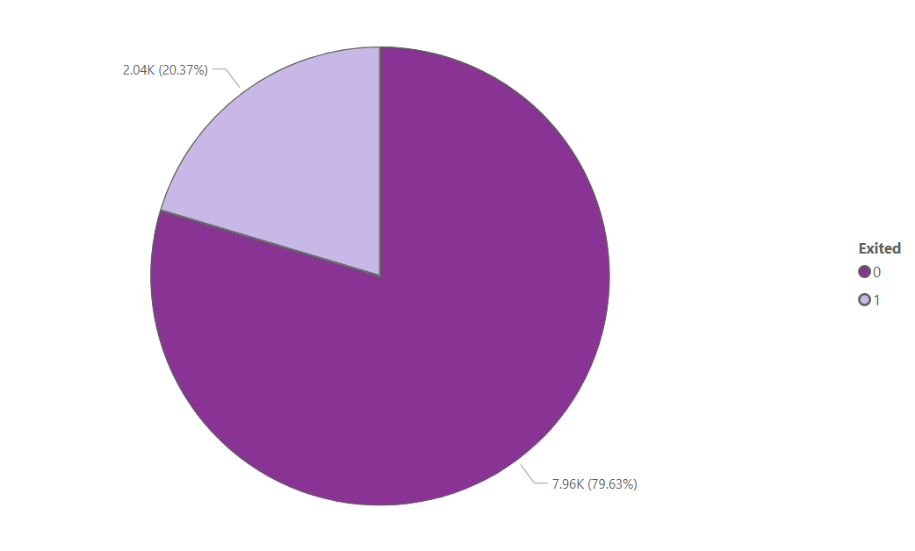
Total Customers By Excited
79.63% of customers are retained (continue with the bank).
20.37% of customers have churned.

Slide 2
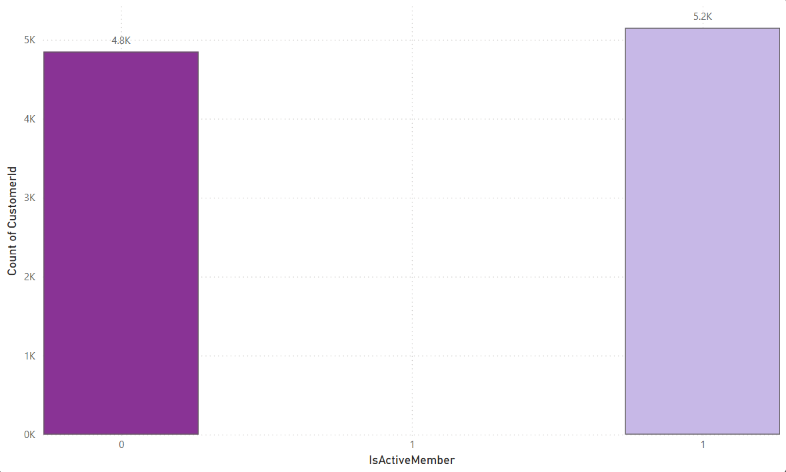
Total customers by Active Member
52% of customers are active members
48% of customers are inactive members

Slide 3
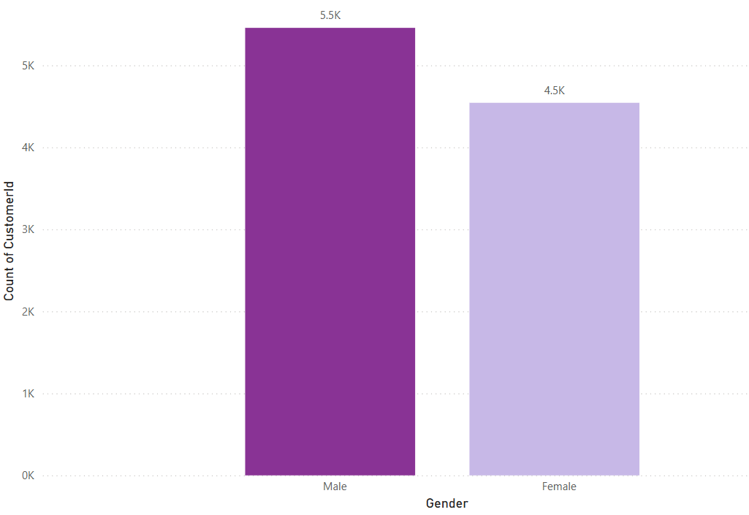
Total Customers by Gender
Male customers(~5.5K) are slightly higher than female customers.
Female customers (~4.5K) form a significant portion, but are fewer than males

Slide 4
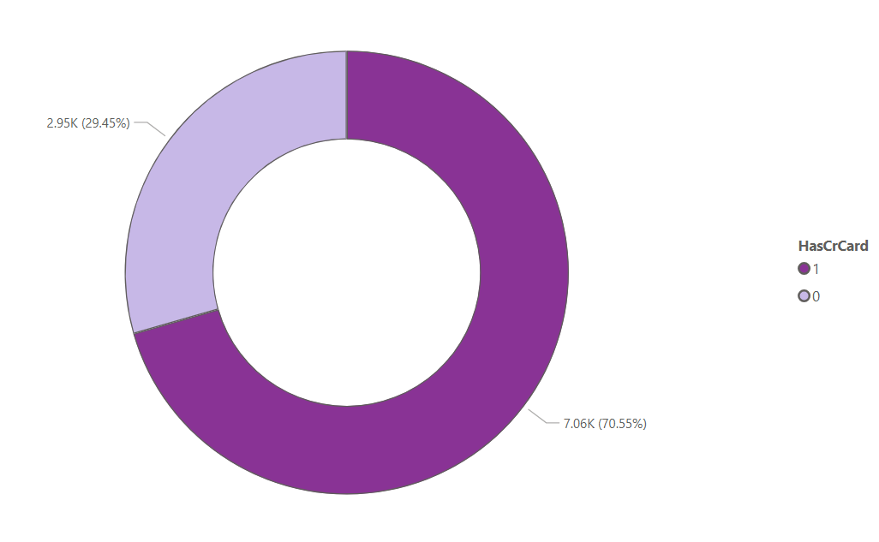
Total customers by Credit Card
70.55% of customers have credit card.
29.45% of customers do not have credit card.

Slide 5
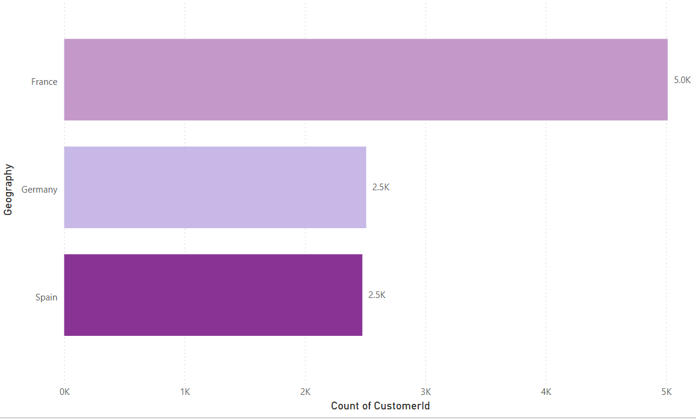
Total Customers By Geography
France has highest number of customers.
Germany and Spain have comparatively fewer customers.

Slide 6
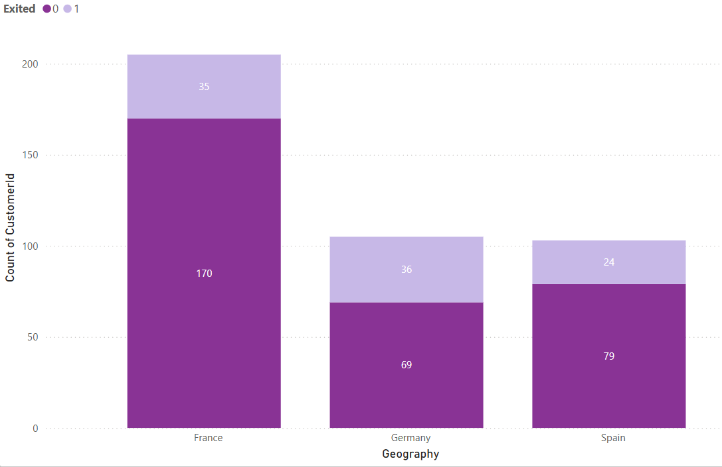
Total Customer By Geography and Churn
France has the highest customer count with moderate churn.
Germany and Spain have fewer customers and lower churn

Slide 7
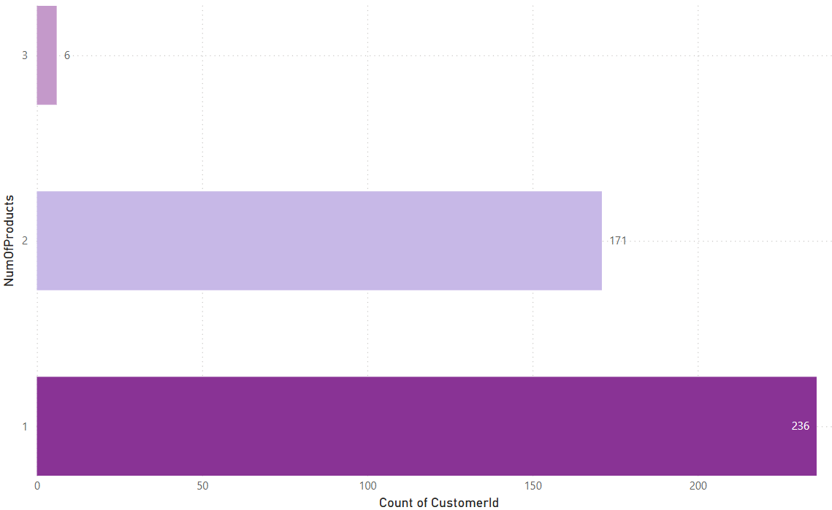
Total Customers By No. Of Products
Most customers have 1 product .
Very few have multiple products.

Slide 8
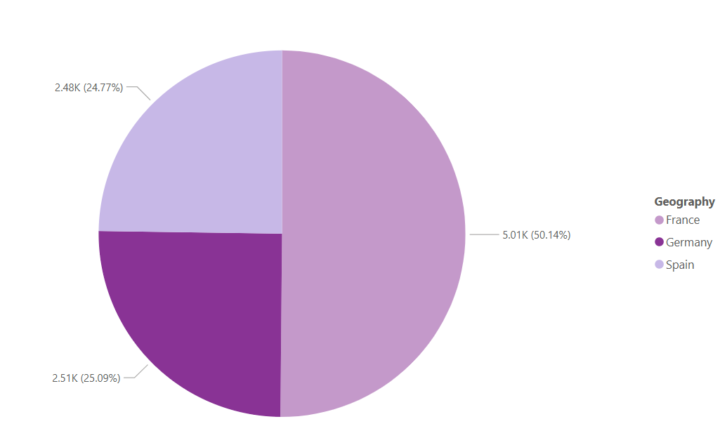
Total churn by Geography
France ~50% customers.
Germany & Spain ~25% each.

Slide 9
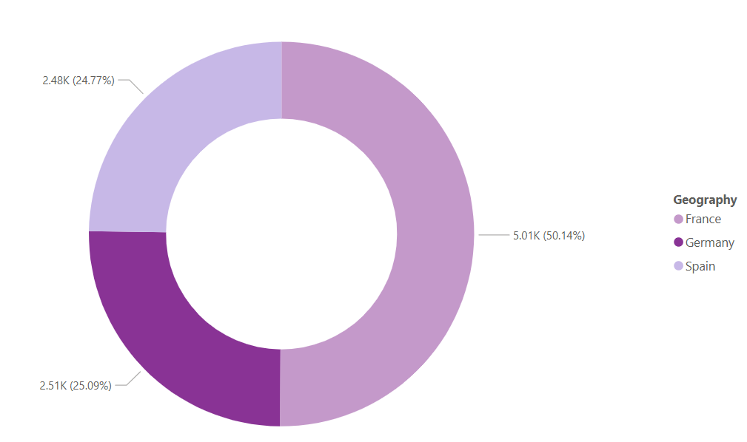
Total Active Members By Geography
Germany has the highest active members.
Spain & France have nearly equal, lower counts.

Slide 10
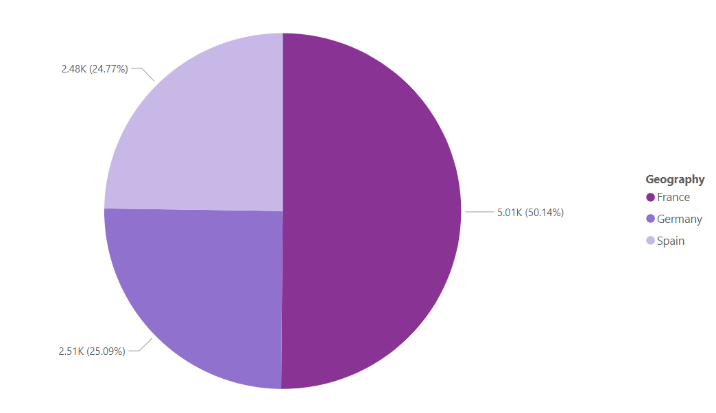
Total Credit Card By Geography
Germany accounts for the highest share of total credit cards.
France and Spain contribute smaller, nearby equal portions.

Slide 11
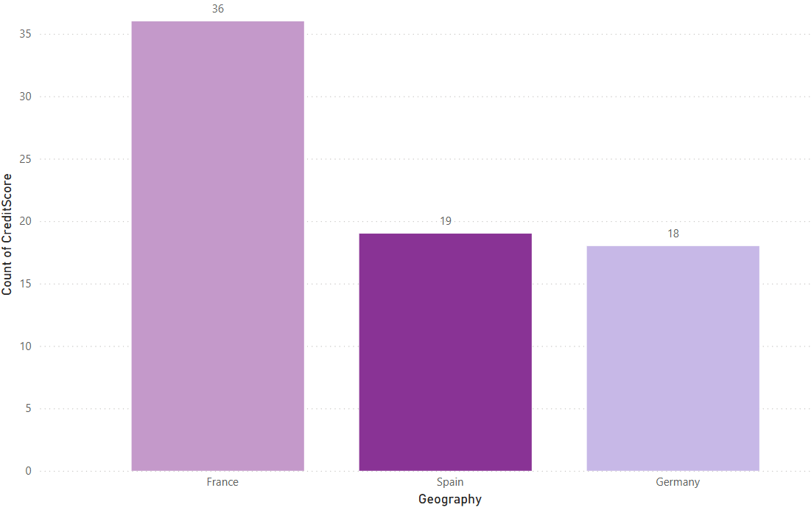
Total Credit Score by Geography
France has the highest total credit score.
Spain and Germany have lower and similar scores.

Slide 12
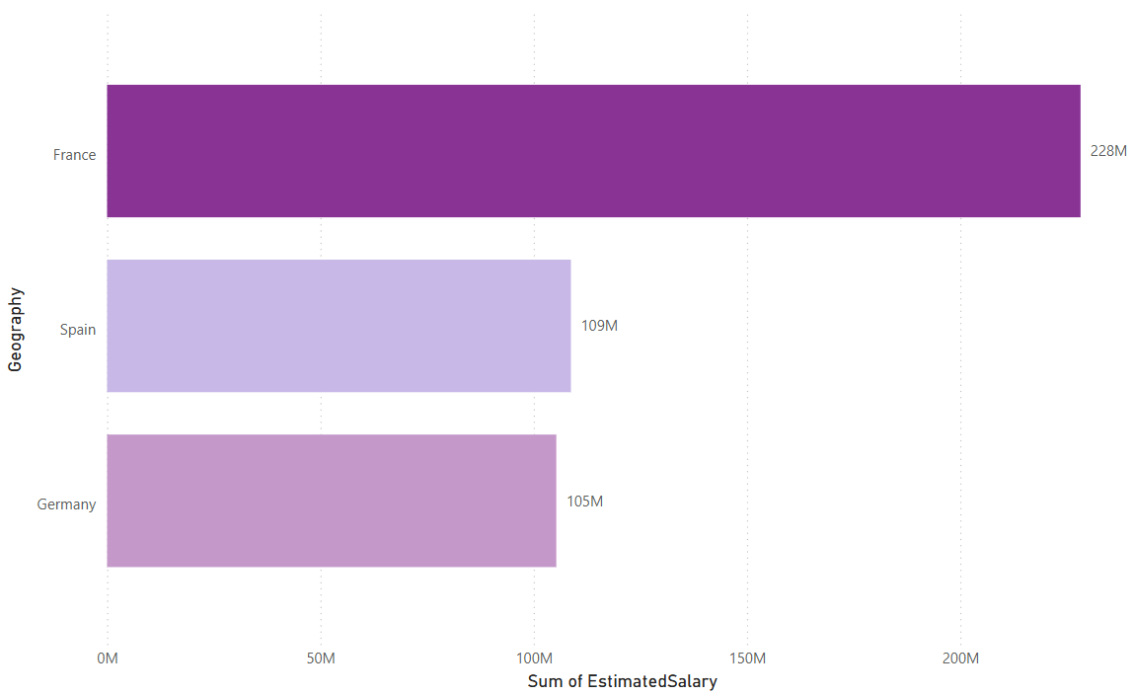
Estimated Salary By Geography
France leads in estimated salary.
Germany & Spain trail behind.

Slide 13
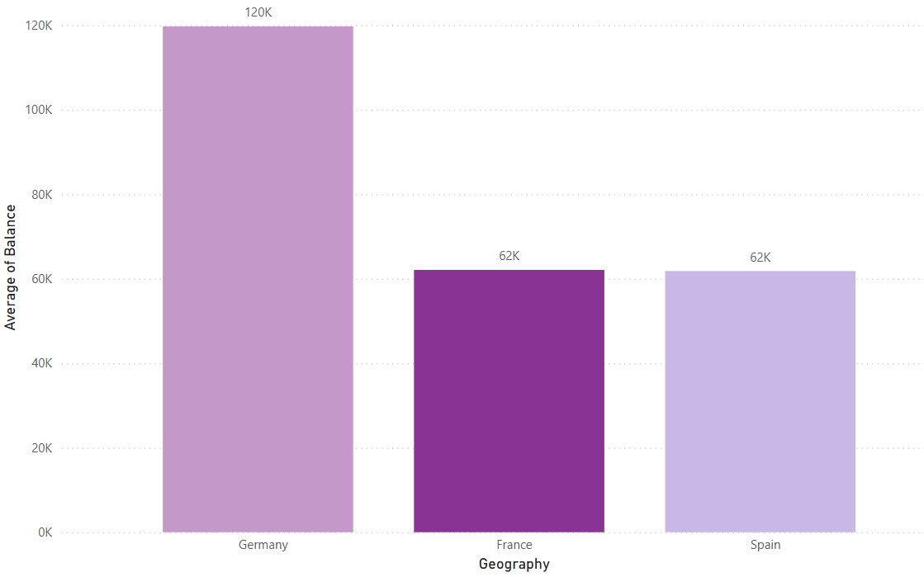
Average Balance By Geography
Germany leads in average balance.
France & Spain are lower.

Slide 14
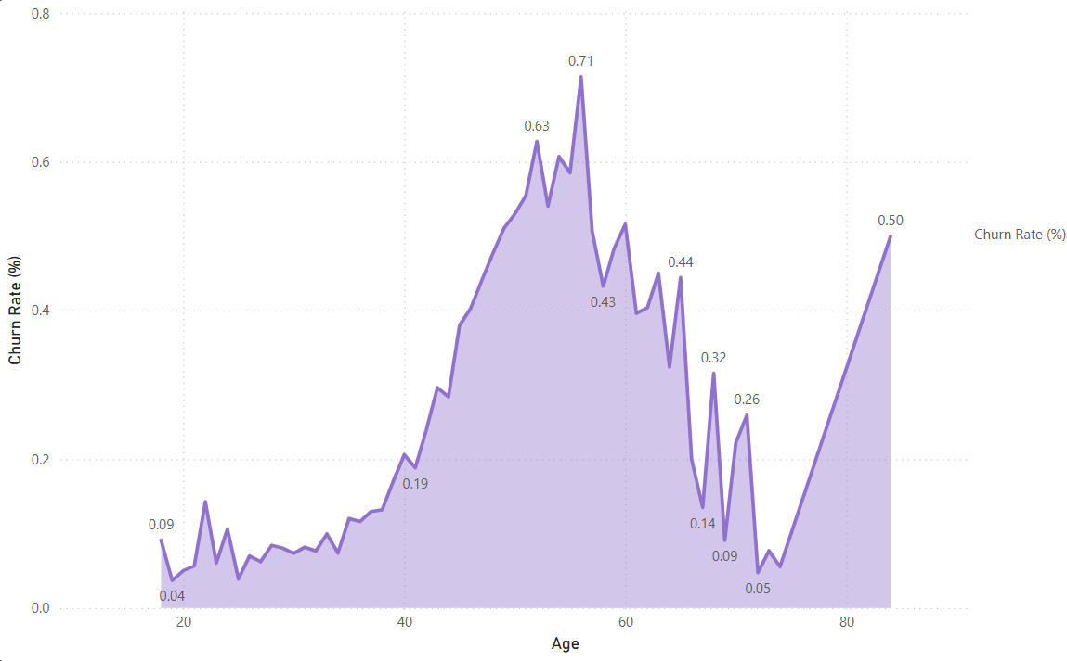
Churn Rate(%) By Age
Low Churn at young ages
Highest churn in middle to older ages

Slide 15
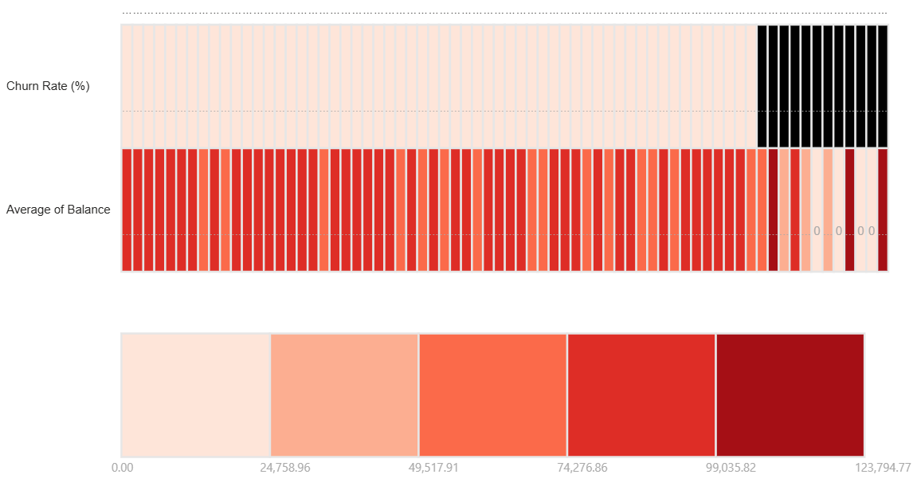
Churn Vs Balance Heatmap
Higher Balance customers show higher churn.
Low balance customers churn less.

Slide 16
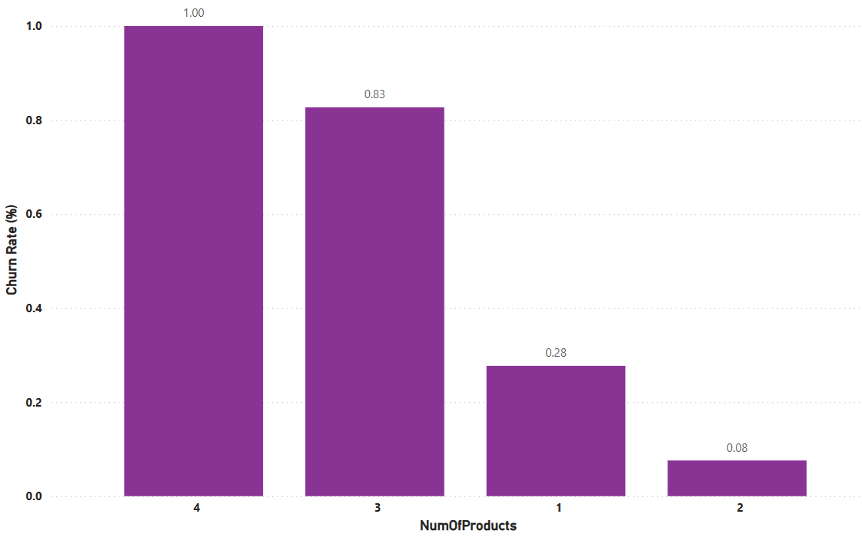
Churn By Product
More products -> Higher Churn
4 product customers have the highest churn.

Slide 17
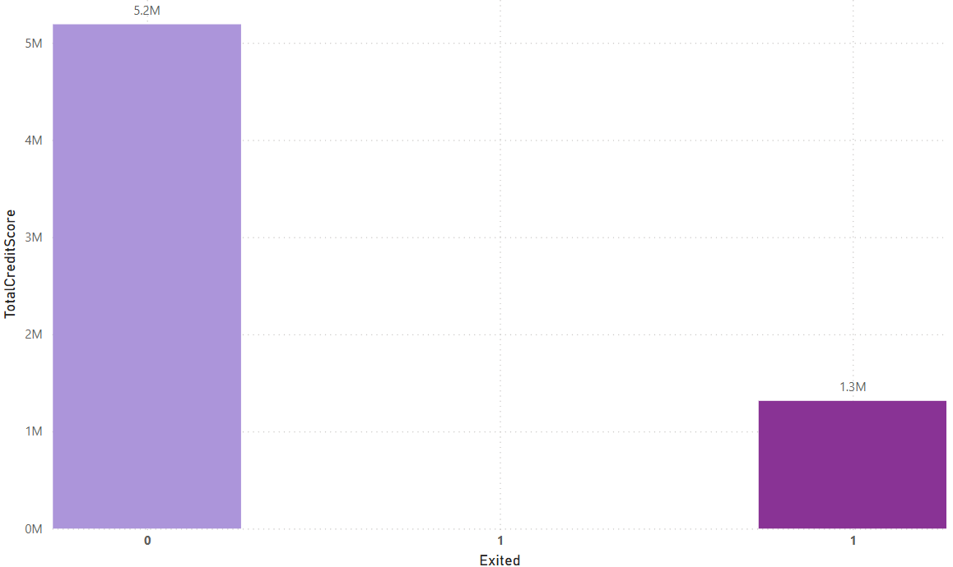
Credit Score Vs Churn
Higher credit score -> less churn.

